Slide 1
BUBBLE SMASH
Team : 9
Rashmi Tripathi
Ankita Wankhede
Manasa Reddy
Saijyothi Gudibandi

Slide 2
INTRODUCTION
This project aims at game development in android studio for android phones
and tablets.
The aim is to develop an interactive game for mobile platform in android
studios and add new features using the technologies we get acquainted during
our course term
There will be a bubble running at random speed on your phone and user needs
to tap on that bubble to smash it. There will be three levels: Easy, Intermediate
and Expert.
The rules of the bubble game are simple, you need to blast as many bubbles as
possible, the more you pop, the higher your score is, Sounds easy? Rest
assured that people are spending hours blasting those bubbles and having the
time of their lives.

Slide 3

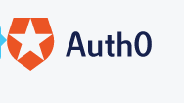
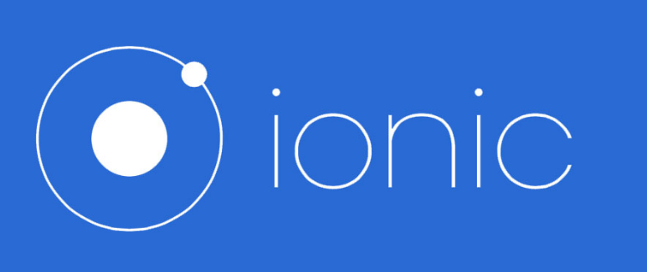



TOOLS AND TECHNOLOGY

Slide 4
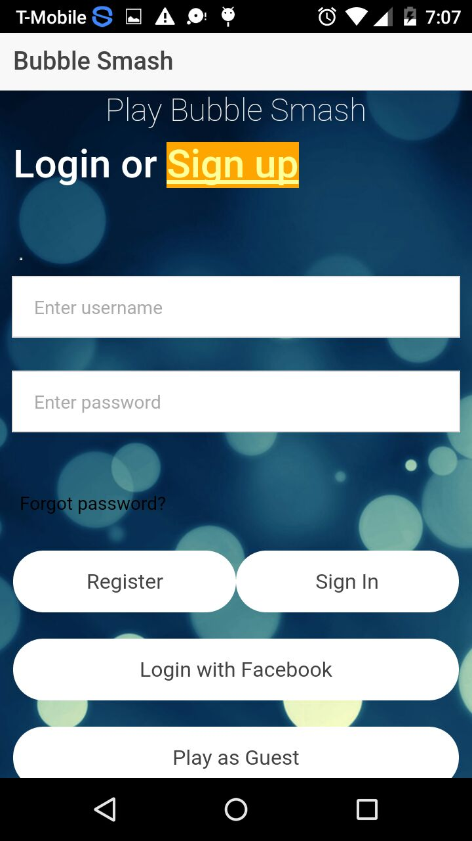
GAME FEATURES
User can create a new account or signup with Facebook or play as a guest. Successfully Login brings the user to the level page.
User details will be stored in Mongo DB once the user successfully registers himself in the application.

Slide 5
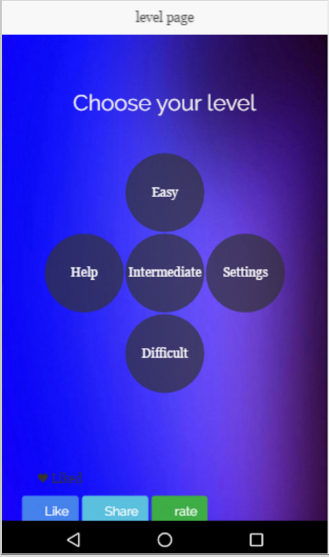
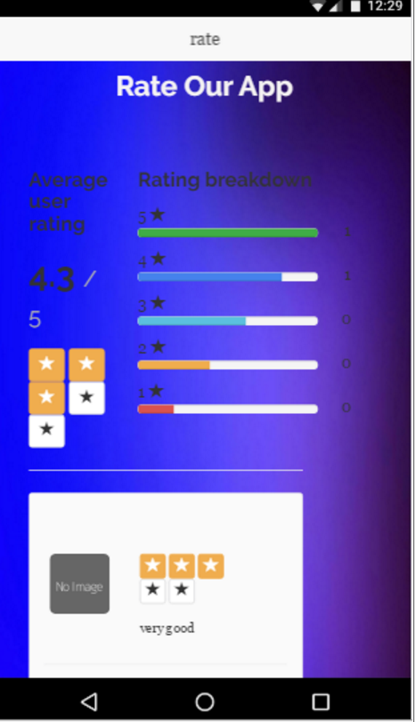
User will be able to select any level (Easy, Intermediate and Expert). Also user can get details about the game rules on clicking help option available in the level page.
User can also like our application on Facebook also he can share the link of this app.
User can rate and review our application on clicking rate button on the level Page
User can update their profile in the settings Page.

Slide 6
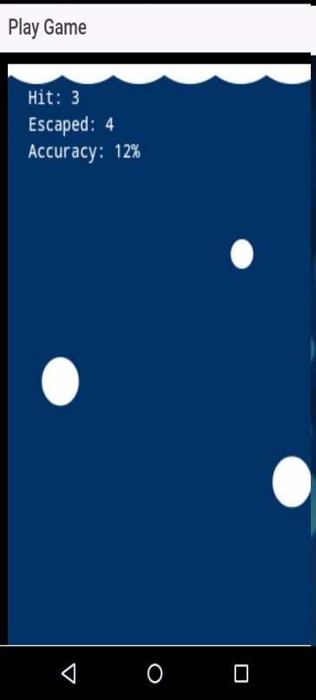
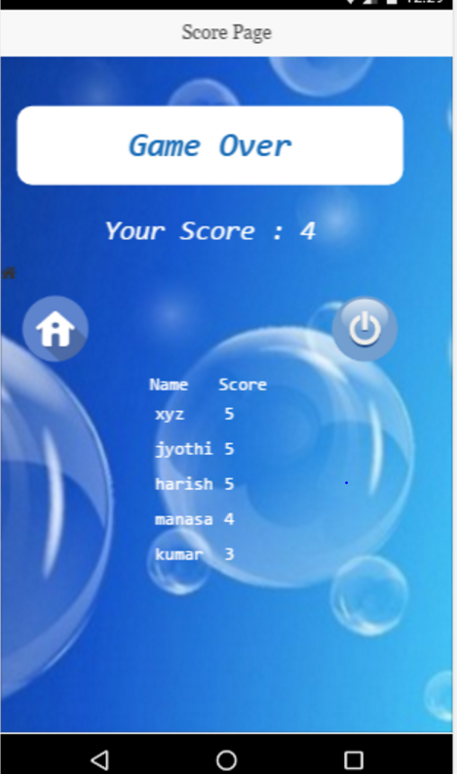
The First image on the right displays the Game Page where the Player will take actions, and the score will be updated dynamically.
Second image displays the Final summary page once the game ends for player.

Slide 7
THANK YOU☺

